Slide 1
Memory Layout of a Process
Lecture 08 (Part B)

Slide 2
Outline of Chap. 7
title “Process Environment”
user-level run-time environment of a process
Lectures:
Part A: program startup and terminates
Sec. 7.1-7.4
Part B: memory layout of a process
Sec. 7.5-7.11

Slide 3
Today’s Goal
Learn how to build a UNIX program with complex and dynamic data structure
linked list, tree, graph, etc.
Deal with segmentation fault problem
10
5
8
7
10
5
20
8
7
10
5
20
7

Slide 4
Layout of the virtual address space of a process
an overview

Slide 5
Addressing space of a process
0
text
initialized data
uninitialized data
(.bss)
heap
stack
address
command-line arg.
environment list

Slide 6
Addressing space of a process
0
text
program code
initialized data
uninitialized data
(.bss)
heap
stack
address
command-line arg.
environment list

Slide 7
Addressing space of a process
0
int a=1000;
int b;
main ()
{
…
ptr = malloc (100);
…
foo (10, 20);
…
}
foo (x, y)
int x;
int y;
{
int m, n;
…
}
text
initialized data
uninitialized data
(.bss)
static data with initial value
heap
stack
address
command-line arg.
environment list

Slide 8
Addressing space of a process
0
int a=1000;
int b;
main ()
{
…
ptr = malloc (100);
…
foo (10, 20);
…
}
foo (x, y)
int x;
int y;
{
int m, n;
…
}
text
initialized data
uninitialized data
(.bss)
heap
static data without initial value
(loader may initialize to zero)
stack
address
command-line arg.
environment list

Slide 9
Addressing space of a process
int a=1000;
int b;
main ()
{
int *ptr;
…
ptr = malloc (100);
…
foo (10, 20);
…
}
foo (x, y)
int x;
int y;
{
int m, n;
…
}
0
text
initialized data
dynamically allocated
memory block
uninitialized data
(.bss)
heap
stack
address
command-line arg.
environment list

Slide 10
Addressing space of a process
0
int a=1000;
int b;
main ()
{
…
ptr = malloc (100);
…
foo (10, 20);
…
}
foo (x, y)
int x;
int y;
{
int m, n;
…
}
text
initialized data
uninitialized data
(.bss)
heap
local (auto) variables
and function call parameters
stack
address
command-line arg.
environment list

Slide 11
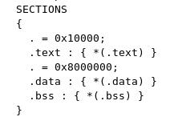
You can modify the memory layout
.c
gcc
please “info ld”
.s
ld script
as
.o
ld
a.out

Slide 12
The text segment
0
text
initialized data
uninitialized data
(.bss)
heap
stack
address
command-line arg.
environment list

Slide 13
The text segment
0
text
the program code is in the text segment
a program always starts execution from address 0
the text segment is protected from writing
program code
initialized data
uninitialized data
(.bss)
heap
stack
address
command-line arg.
environment list

Slide 14
The text segment
0
text
the program code is in the text segment
a program always starts execution from address 0
the text segment is protected from writing
initialized data
uninitialized data
(.bss)
heap
0
_init:
....
//system initialization
call _main
_main:
//the program you write
stack
address
command-line arg.
environment list
address

Slide 15
Where to place data?
variables of C/C++

Slide 16
Variables in C/C++
global and static variables
local variables
static variables
automatic variables
int a;
foo ()
{
int x;
static int z;
...
}

Slide 17
Variables in C/C++
global and static variables
local variables
static variables
automatic variables
Static variables are always at a fixed place in data segment
int a;
foo ()
{
int x;
static int z;
...
}

Slide 18
Variables in C/C++
global and static variables
local variables
static variables
automatic variables
Static variables are always at a fixed place in data segment
int a;
foo ()
{
int x;
static int z;
...
}

Slide 19
Variables in C/C++
global and static variables
local variables
static variables
automatic variables
Automatic variables are allocated dynamically
allocated upon function call
in stack segment
not at a fixed place
int a;
foo ()
{
int x;
static int z;
...
}

Slide 20
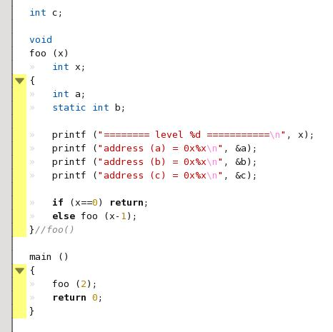
Demo: recursive_call

Slide 21
Demo: recursive_call
global static

Slide 22
Demo: recursive_call
local static

Slide 23
Demo: recursive_call
automatic

Slide 24
Demo: recursive_call
b and c are always at a fixed address
a is in different address each time

Slide 25
Addressing space of a process
0
text
initialized data
static data placed here
uninitialized data
(.bss)
heap
stack
address
command-line arg.
environment list

Slide 26
Addressing space of a process
0
int a=1000;
int b;
main ()
{
…
ptr = malloc (100);
…
foo (10, 20);
…
}
foo (x, y)
int x;
int y;
{
int m, n;
…
}
text
initialized data
uninitialized data
(.bss)
static data with initial value
heap
stack
address
command-line arg.
environment list

Slide 27
Addressing space of a process
0
int a=1000;
int b;
main ()
{
…
ptr = malloc (100);
…
foo (10, 20);
…
}
foo (x, y)
int x;
int y;
{
int m, n;
…
}
text
initialized data
uninitialized data
(.bss)
heap
static data without initial value
(loader may initialize to zero)
stack
address
command-line arg.
environment list

Slide 28
The stack segment
to place automatic local variables

Slide 29
Addressing space of a process
0
int a=1000;
int b;
main ()
{
…
ptr = malloc (100);
…
foo (10, 20);
…
}
foo (x, y)
int x;
int y;
{
int m, n;
…
}
text
initialized data
uninitialized data
(.bss)
heap
local (auto) variables
and function call parameters
stack
address
command-line arg.
environment list

Slide 30
Addressing space of a process
0
text
initialized data
main ()
{
foo ();
}
foo () {
go ();
}
go () {
…
}
uninitialized data
(.bss)
heap
frame of
go ()
frame of
foo ()
stack
frame of
main ()
address
command-line arg.
environment list

Slide 31
Stack frame: a detailed view
stack
main () {
foo (10, 20, 30);
rethere:
}
foo (a, b, c)
int a, b, c;
{
int x, y, z;
…
}
z
local automatic variables
y
x
addr(rethere)
10
a
20
b
function call parameters
30
c
frame of
main ()
address

Slide 32
In-Class Exercise
Q: why the function “printf()” can have variable number of parameters?
printf (“a=%d, b=%c, c=%d\n”, a, b, c);
printf (“a=%d, b=%c\n”, a, b);
How to write such a function?

Slide 33
Heap for dynamic data structure
0
text
initialized data
uninitialized data
(.bss)
heap
stack
address
command-line arg.
environment list

Slide 34
What’s the heap for
memory space that you allocated dynamically
for dynamic data structure
such as linked list, tree, graph
accessed through pointors
for memory objects you allocate through
C: malloc() and free()
C++: new and delete

Slide 35
Example: linked list
initially there is nothing in the memory space

Slide 36
Example: linked list
You allocate a memory space for the 1st node
through some memory allocation function to the system
10

Slide 37
Example: linked list
(2) You repeatedly allocate memory space to form a linked list
through some memory allocation function to the system
10
5
8
7

Slide 38
Example: linked list
(3) You may allocate a new node and insert
through some memory allocation function to the system
10
5
20
8
7

Slide 39
Example: linked list
(4) You may remove a node and free the memory space
through some memory deallocation function to the system
10
5
20
7

Slide 40
Example: linked list
All these require dynamic memory management
And addresses of these nodes are irregular
10
5
20
8
7
address
20
10
7
5
8

Slide 41
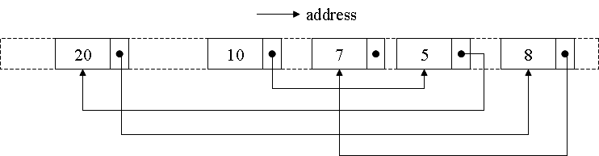
The dynamic data structure is in heap segment
0
text
initialized data
uninitialized data
(.bss)
heap
stack
address
command-line arg.
environment list

Slide 42
How to realize dynamic data structure on UNIX?
C: malloc() and free ()
C++: new and delete

Slide 43
Standard library functions for dynamic memory allocation
malloc (size)
free (pointor)

Slide 44
Demo: linked_list
10
5
20
8
7
major operations:
AppendKey_LinkedList (this, key)
DeleteKey_LinkedList (this, key)

Slide 45
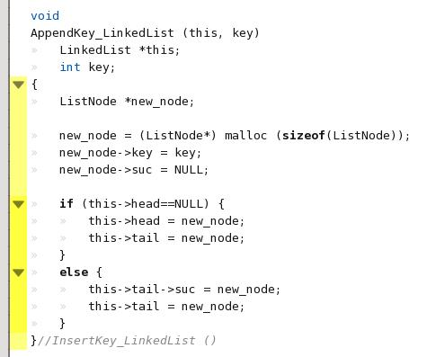
Demo: linked_list
10
5
20
8
7
to allocate memory space for a new node:

Slide 46
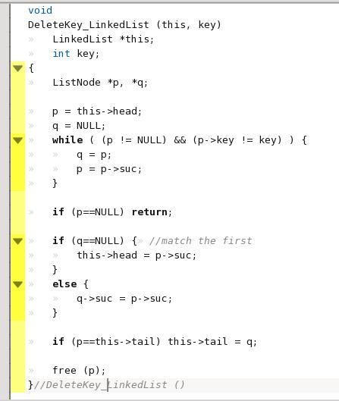
Demo: linked_list
to release the memory space of a node:
10
5
20
8
7

Slide 47
What does malloc() and free() do?

Slide 48
What does malloc() and free () do?
text
void *p, *q, *r, *s;
…
p = malloc (20);
…
q = malloc (40);
…
r = malloc (10);
…
free (q);
…
s = malloc (30);
initialized data
un-initialized data
heap
program
trace
address

Slide 49
What does malloc() and free () do?
text
void *p, *q, *r, *s;
…
p = malloc (20);
…
q = malloc (40);
…
r = malloc (10);
…
free (q);
…
s = malloc (30);
initialized data
un-initialized data
allocate 20 bytes of memory
p
heap bottom
heap
program
trace
address

Slide 50
What does malloc() and free () do?
text
void *p, *q, *r, *s;
…
p = malloc (20);
…
q = malloc (40);
…
r = malloc (10);
…
free (q);
…
s = malloc (30);
initialized data
un-initialized data
allocate 40 bytes of memory
p
q
heap bottom
heap
program
trace
address

Slide 51
What does malloc() and free () do?
text
void *p, *q, *r, *s;
…
p = malloc (20);
…
q = malloc (40);
…
r = malloc (10);
…
free (q);
…
s = malloc (30);
initialized data
un-initialized data
allocate 10 bytes of memory
p
q
heap bottom
r
heap
program
trace
address

Slide 52
What does malloc() and free () do?
text
void *p, *q, *r, *s;
…
p = malloc (20);
…
q = malloc (40);
…
r = malloc (10);
…
free (q);
…
s = malloc (30);
initialized data
un-initialized data
free the memory for q
p
space for q
released
heap bottom
r
heap
program
trace
address

Slide 53
What does malloc() and free () do?
text
void *p, *q, *r, *s;
…
p = malloc (20);
…
q = malloc (40);
…
r = malloc (10);
…
free (q);
…
s = malloc (30);
initialized data
un-initialized data
allocate 30 bytes of memory
p
s
heap bottom
r
heap
the system will try to re-use available space
program
trace
address

Slide 54
What does malloc() and free () do?
text
initialized data
un-initialized data
p
s
heap bottom
Most of the time, the heap contains un-contiguous memory segments
r
heap
address

Slide 55
How to manage the heap (1)
the internal implementation at user level

Slide 56
The Heap
int a=1000;
int b;
main ()
{
int *ptr
…
ptr = malloc (100);
…
foo (10, 20);
…
}
foo (x, y)
int x;
int y;
{
int m, n;
…
}
0
text
initialized data
dynamically allocated
memory block
uninitialized data
(.bss)
heap
stack
address
command-line arg.
environment list

Slide 57
Functions for dynamic memory allocation
main ()
{
…
p = malloc (sizeof(struct ss);
…
}
standard library functions
malloc ()
free ()
calloc ()
realloc ()
brk ()
sbrk ()
system call
to set end of data segment
kernel

Slide 58
How malloc() and free() works
virtual address
Linked list to keep track of all free space
end of heap
used space

Slide 59
How malloc() and free() works
virtual address
new memory block allocated by malloc
end of heap
used space

Slide 60
How malloc() and free() works
virtual address
All in virtual address space and
has nothing to do with OS kernel
end of heap
used space

Slide 61
How to manage the heap (2)
the internal implementation at system level

Slide 62
Functions for dynamic memory allocation
main ()
{
…
p = malloc (sizeof(struct ss);
…
}
standard library functions
malloc ()
free ()
calloc ()
realloc ()
brk ()
sbrk ()
system call
to set end of data segment
kernel

Slide 63
What does malloc do?
Step 1: trying to find an available space for the new object within current range of the heap
Step 2: if Step 1 failed, call brk() to ask for more address space from the OS
text
initialized data
un-initialized data
p
s
heap bottom
r
heap
the system will try to re-use available space
address

Slide 64
The Heap
0
int a=1000;
int b;
main ()
{
…
ptr = malloc (100);
…
foo (10, 20);
…
}
foo (x, y)
int x;
int y;
{
int m, n;
…
}
text
initialized data
dynamically allocated
memory block
uninitialized data
(.bss)
heap
set by brk () and sbrk () system call
stack
address
command-line arg.
environment list

Slide 65
The Heap
0
int a=1000;
int b;
main ()
{
…
ptr = malloc (100);
…
foo (10, 20);
…
}
foo (x, y)
int x;
int y;
{
int m, n;
…
}
text
initialized data
dynamically allocated
memory block
uninitialized data
(.bss)
heap
malloc () calls brk()/sbrk() when
run out of memory
stack
address
command-line arg.
environment list

Slide 66
What brk() and sbrk() does?
0
text
initialized data
uninitialized data
(.bss)
extend by brk() or sbrk ()
heap
0x10000
0x12000
stack
address
command-line arg.
environment list

Slide 67
Review: virtual-to-physical address translation
virtual address
page#
offset
…
…
physical page #
offset
page table
physical address

Slide 68
OS view on managing memory of a process
virtual address
page#
offset
…
…
page B
OS manages fixed-size pages (e.g. 4KB)
…
page C
…
…
page A
page table
…
physical memory

Slide 69
What OS does for brk()/sbrk()?
virtual address
new page table entry and physical page
for the extended address space
page#
offset
…
…
page B
…
page C
…
…
page A
page table
page D
…
physical memory

Slide 70
Environment Variables

Slide 71
Environment Variables
0
text
initialized data
access by
getenv ()
putenv ()
setenv ()
uninitialized data
(.bss)
heap
HOME=“/home/ycma”
PATH=“/bin:/usr/local/bin”
USER=“ycma”
…
stack
address
command-line arg.
environment list

Slide 72
Appendix: long-jump across stack frame

Slide 73
Long jump across stack frames
#include <setjmp.h>
jmp_buf jmpbuffer;
main () {
…
if (setjmp(jmpbuffer)!=0)
printf (“error\n”);
foo ();
}
foo () {
…
go ();
}
go () {
longjmp (jmpbuffer, 1);
}

Slide 74
Long jump across stack frames
#include <setjmp.h>
jmp_buf jmpbuffer;
main () {
…
if (setjmp(jmpbuffer)!=0)
printf (“error\n”);
foo ();
}
foo () {
…
go ();
}
go () {
longjmp (jmpbuffer, 1);
}
first execute: set jmpbuffer and returns 0

Slide 75
Long jump across stack frames
#include <setjmp.h>
jmp_buf jmpbuffer;
main () {
…
if (setjmp(jmpbuffer)!=0)
printf (“error\n”);
foo ();
}
foo () {
…
go ();
}
go () {
longjmp (jmpbuffer, 1);
}
stack
stack
frame of
go ()
frame of
foo ()
frame of
main()
frame of
main()
trying to come back to main() directly

Slide 76
Long jump across stack frames
#include <setjmp.h>
jmp_buf jmpbuffer;
main () {
…
if (setjmp(jmpbuffer)!=0)
printf (“error\n”);
foo ();
}
foo () {
…
go ();
}
go () {
longjmp (jmpbuffer, 1);
}
as if it is returned from setjmp

